Slide 1

Financial Analysis and Forecasting Reporting
An insightful overview of market trends and financial projections

Slide 2
Executive Summary
Objective: To analyse historical stock data and develop financial forecasts
Key findings: Linear regression provided the most accurate forecasts
Recommendations: Focus on long-term investment strategies and improve operational efficiency

Slide 3
Introduction
Brief overview of the dataset: Historical stock prices and volumes
Purpose of the analysis: To predict future financial metrics and assess the company’s financial health

Slide 4
Financial Model Summary
Income Statement Highlights
Cash Flow Statement Highlights
Year | Revenue | COGS | Gross Profit | Operating Expenses | Net Income
2015 | $2,043.94M | $1,226.36M | $817.58M | $100.00M | -$182.42M
2016 | $2,238.83M | $1,343.30M | $895.53M | $100.00M | -$204.47M
... | ... | ... | ... | ... | ...
2020 | $3,557.54M | $2,134.52M | $1,423.02M | $100.00M | -$277.48M
Year | CF from Operations | CF from Investing | CF from Financing | Free Cash Flow
2015 | -$182.42M | -$50.00M | $0.00M | -$232.42M
2016 | -$204.47M | -$50.00M | $0.00M | -$254.47M
... | ... | ... | ... | ...
2020 | -$277.48M | -$50.00M | $0.00M | -$327.48M

Slide 5
Balance Sheet Overview
Year | Cash & Equivalents | PP&E | Total Assets | Long-Term Debt | Total Equity | Total Liabilities & Equity
2015 | $50.00M | $200.00M | $250.00M | $100.00M | $150.00M | $250.00M
2016 | $28.55M | $250.00M | $278.55M | $100.00M | $178.55M | $278.55M
... | ... | ... | ... | ... | ... | ...
2020 | -$327.48M | $300.00M | -$27.48M | $100.00M | -$127.48M | -$27.48M

Slide 6
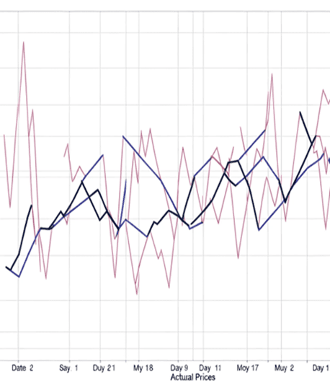
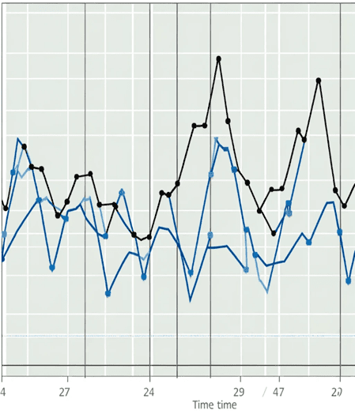
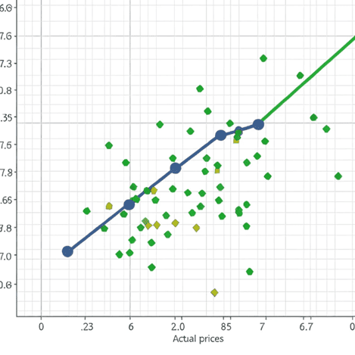
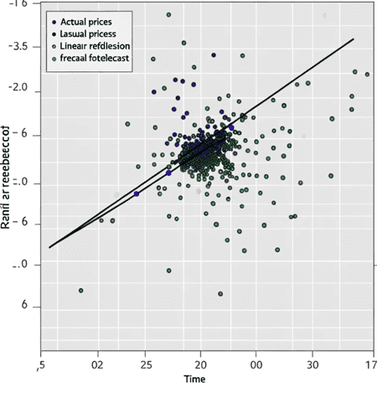
Forecasting Techniques
Moving Average
This line chart displays the actual closing stock prices alongside the moving average forecasted values over time, with distinct lines for each to facilitate comparison and trend analysis
Linear Regression
This scatter plot showcases the Linear Regression Forecast. It includes individual data points for the actual closing stock prices and a straight line for the linear regression forecast, illustrating the relationship between time and stock prices.

Slide 7
Sensitivity Analysis
The analysis varied the time intervals for the linear regression model and observed the following impacts on forecast accuracy (MAE and RMSE):
Weekly ('W'): MAE = 187.67, RMSE = 247.73
Biweekly ('2W'): MAE = 180.26, RMSE = 239.27
Monthly ('M'): MAE = 176.73, RMSE = 224.34
Increasing the time interval from weekly to biweekly and then to monthly generally improves the forecast accuracy, as indicated by the decreasing MAE and RMSE values
This suggests that using longer time intervals can help capture broader trends in the data, reducing the impact of short-term fluctuations
The monthly interval provided the most accurate forecasts in this analysis, which may indicate that the stock price movements are more predictable on a monthly scale than on shorter time scales for this particular dataset

Slide 8
Recommendations
Based on the forecast accuracy, prioritise investments in stable, long-term assets
Operational changes to enhance efficiency based on the financial model insights

